Slide 1
Chicago Type of Crime
CS 547 Deep Dive Project
Group 8
Chongbin Yao, Hongxiao Chen, Vincent Lyu, Wendi Zhao

Slide 2
Introduction

Slide 3
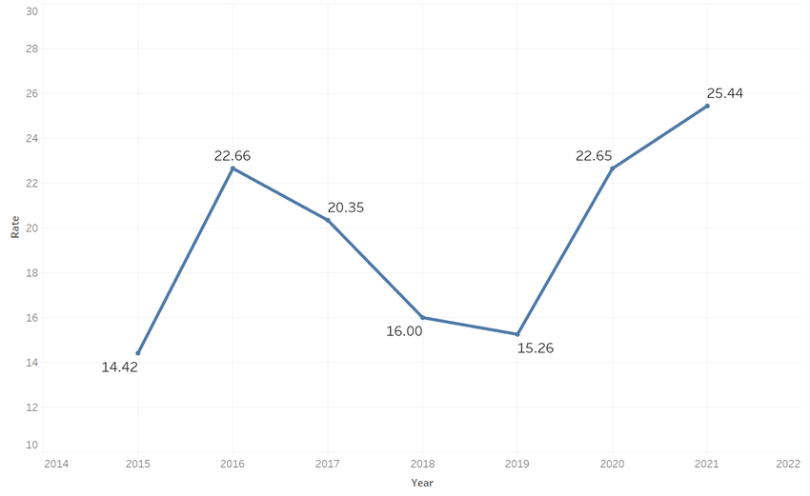
Chicago Type of Crime
Chicago massive gun-shoot trend
Major dataset: https://data.cityofchicago.org/Public-Safety/Crimes-2001-to-Present/ijzp-q8t2/about_data
Chongbin Yao
Notes:
Hi we are group 8 working on Chicago crime prediction project. We choose this project because the increase trend in gun shoot events in chicago area.
In this project, we aim at prevent future crimes in Chicago area by providing a guide to arrange police force in potential high risk areas.
So we are building a deep learning project with data from City of chicago official government website, and also include other data like holidays, weather, to predict the crime amount and types in different areas. I will let Wendi introduce our data process

Slide 4
Data Exploration & Processing
By Wendi Zhao
Wendi Zhao

Slide 5
Data Source
Chicago Crime Data (https://data.cityofchicago.org/Public-Safety/Crimes-2001-to-Present/ijzp-q8t2)
Holidays (https://gist.github.com/shivaas/4758439)
Weather (https://www.ncdc.noaa.gov/cdo-web/datasets)
Wendi Zhao

Slide 6
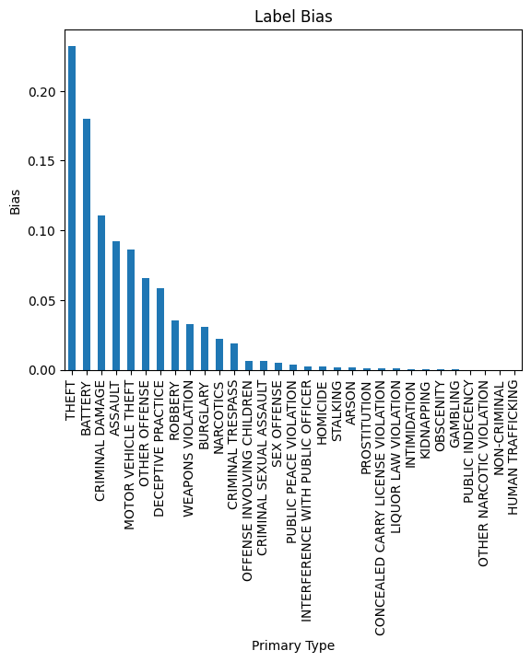
Data Exploration
Label: Primary Type of Crime
31 crime types
Observation: large bias for crime types
Wendi Zhao

Slide 7
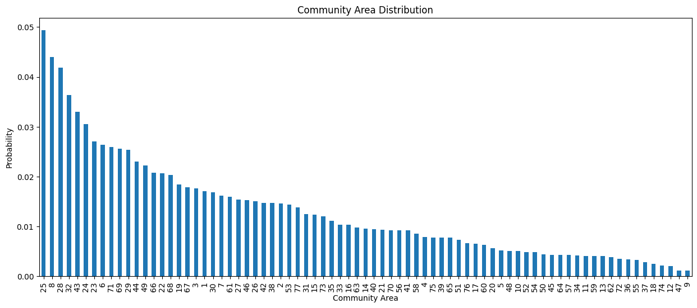
Data Exploration (cont.)
Features
Block, Location Description, District, Ward, Community Area, Latitude, Longitude
Hour of the day
Temperature, Precipitation, Snow
Holidays
Observation
Significant impact of location-related features on crime type distribution
Wendi Zhao

Slide 8
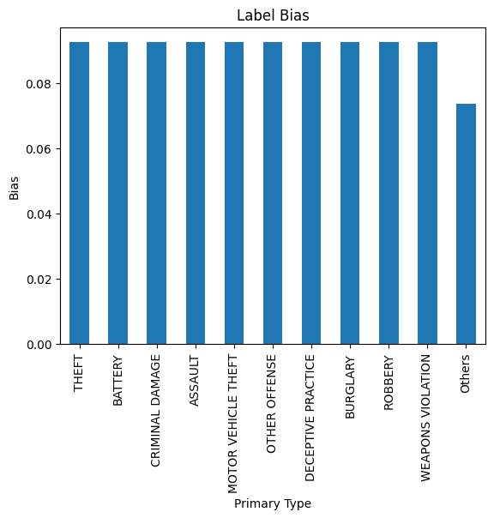
Data Processing
Unbalanced dataset (crime type)
Select the Top 10 most popular crime types
Group the rest as the type “Others”
Undersampling/Oversampling
11 crime types for training
Convert datetime to pandas timestamps
Encode non-numerical data
Wendi Zhao

Slide 9
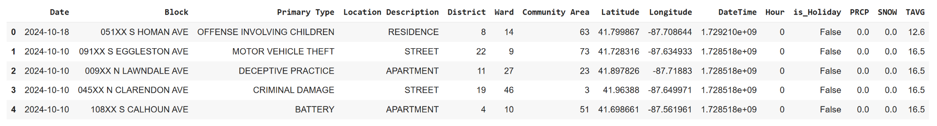
Dataset
Final dataset
Wendi Zhao

Slide 10
Model Design & Training
Hongxiao Chen
Vincent Lyu

Slide 11
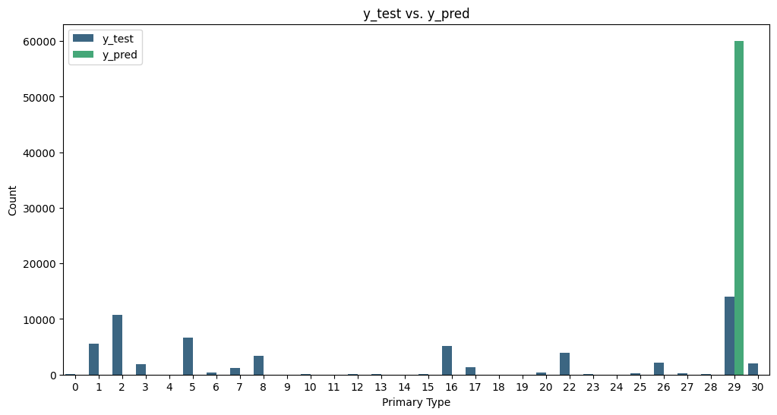

Model Design
Try Logistic Regression as baseline model, poor performance due to class imbalance.
Hongxiao Chen
Notes:
At first we try logistic regression as the baseline model, but it predicts all classes as “theft” due to class imbalance, resulting in poor accuracy of the model on generalized dataset. This is because the model is trying to minimize the loss and ignores the minorities. This problem is solved by grouping and resampling as introduced before.

Slide 12
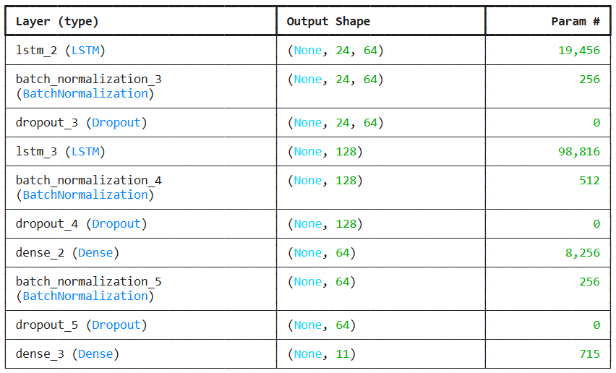
Model Design
To incorporate temporal data, we decide to use LSTM (Long short-term memory)
Input: Sequence of previous 24 crimes
Hidden: LSTM layers to capture temporal dependencies.
Dropout and batch normalization enhance generalization to unseen data.
Output: Predict the type of crime (e.g., theft or robbery)
Hongxiao Chen
Notes:
To incorporate temporal data, we decide to use LSTM. Here is the structure of our model. LSTM can use sequence of previous crimes to predict future crime type. It can capture long-term dependencies. The input layer takes a sequence of previous 24 crimes. Dropout and batch normalization are introduced to enhance generalization on unseen data. Finally the output layer is a softmax activation function predicting the crime as one of the 11 types.

Slide 13
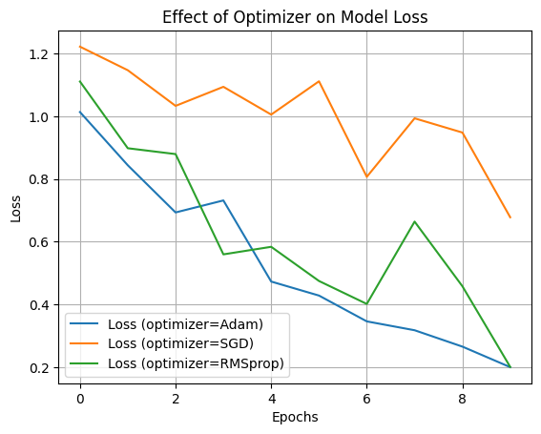
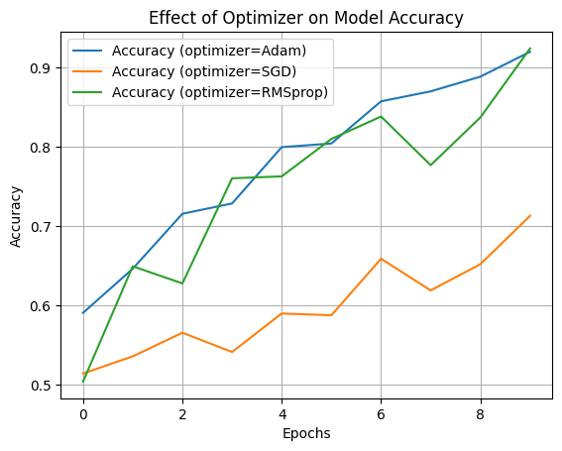
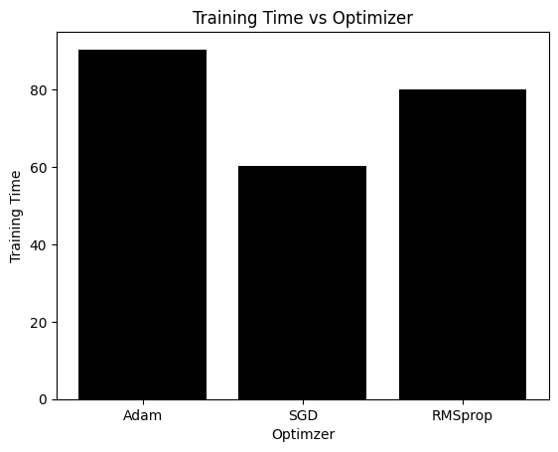
Model Design - Optimizer Choice
Optimizers Evaluated
Adam, SGD, and RMSprop
Accuracy, Loss, Training Time
Adam: best accuracy
Adam and RMSprop: Significant reduction in loss, while SGD struggled to converge.
SGD was the fastest, Adam provided the best balance between speed and performance.
Overall Choice: Adam
Vincent Lyu
Notes:
To optimize our model, we compared Adam, SGD, and RMSprop optimizers. Adam consistently performed the best, achieving high accuracy and reducing loss faster than the others. While SGD was the fastest to train, it struggled to converge effectively. Ultimately, Adam provided the best tradeoff between performance and training time, making it our optimal choice for this task

Slide 14
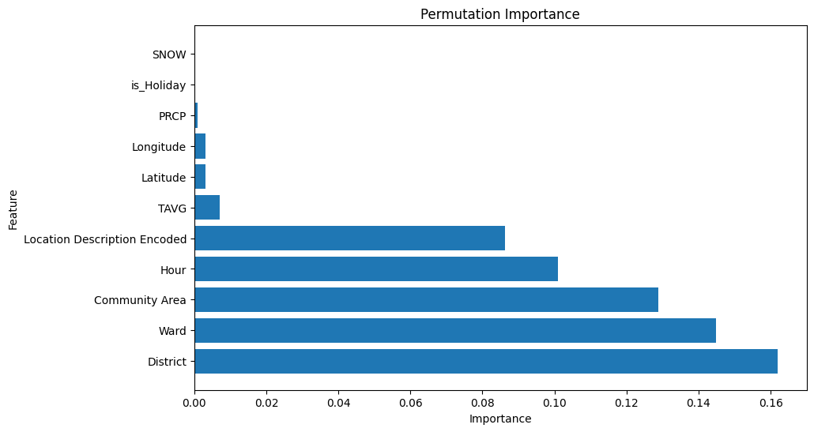
Model Insight - What Drives Crime?
Permutation Importance
Purpose
Insights into data-driven factors influencing the model’s decisions.
Vincent Lyu
Notes:
To understand what drives crime and make our model interpretable, we conducted a Permutation Importance analysis. This revealed that District, Ward, and Community Area were the top contributors, highlighting the location-specific nature of crimes. Hour also played a significant role, showing crime peaks at certain times.
Interestingly, Location Description provided additional insights, while features like PRCP, TAVG, and is_Holiday had minimal impact on overall predictions.
We also attempted SHAP analysis for deeper interpretability, but due to TensorFlow compatibility issues, it wasn’t feasible. Permutation Importance, however, offered valuable insights, and future work could revisit SHAP with updated frameworks.

Slide 15
Conclusion
Notes:
In this project, we successfully developed a deep learning model to predict crime patterns in Chicago, leveraging diverse data sources such as government crime reports, weather, and holidays. Our work provides actionable insights to support better resource allocation for law enforcement, with the ultimate goal of enhancing public safety.

Slide 16
Future steps
Fine-tuning model to increase prediction accuracy
Enlarge the model with more data from other cities
Use the model to predict other cities
Chongbin Yao
Notes:
Moving forward, we plan to fine tuning the model to increase accuracy. Additionally, we aim to expand the scope of the project to include predictive analysis for other cities, adapting the model to diverse urban environments.

